Slide 1
Resource Allocation in Wireless Networks
M. Rasti
Amirkabir University of Technology

Slide 2
Edmodo Group Code
yjbmfu

Slide 3

Lecture 2
I- Basics of Wireless Networks
  1- Introduction of Wireless Networks and Radio Resources
  2- Categories of Wireless Networks and Taxonomy of Hot Topics Research Areas on Resource Allocation in Wireless Networks
II- Techniques for Modeling and Analysis of Radio Resource Allocation in Wireless Networks
  3- Convex Optimization
  4- Game Theory
III- Physical Layer Resource Allocation in Wireless Networks
  5- General System Model and Preliminary Concepts
  6- Power Control in Wireless Cellular Networks
  7- Joint Power and Admission Control in Cellular Wireless Networks
  8- Cell Association in Cellular Networks
  9- Application of Game Theory in Physical Layer Resource Allocation in Wireless Networks
  10- Joint Power and Admission Control in Cognitive Radio Network

Slide 4
Lecture 2 Outline
Different Types of Wireless Networks
Taxonomy of Hot Topics Research Areas on Resource Allocation in Wireless Networks
Summary and Concluding Remarks
  How To Approach Resource Allocation Problems?
  Guidelines on How to Select The Term Project

Slide 5
Different Types of Wireless Networks
From Infrastructure Point of View
  Infrastructure-based Networks
    Cellular Wireless Networks
    Relayed Wireless Networks
  Ad hoc/Sensor Wireless network
  Mesh Wireless Networks
From MAC Types Point of View
  CDMA Wireless Networks
  OFDMA Wireless Networks
  SDMA (MIMO) Wireless Networks
  TDMA Wireless Networks
From Spectrum Access Point of View
  Traditional Wireless Radio network (Fixed Spectrum Access by licensed operator Only)
  Cognitive Radio Networks (Dynamic Spectrum Access)

Slide 6
Different Types of Wireless Networks
From Heterogeneity Point of View
  Homogeneous Wireless Networks
  Heterogeneous Wireless Networks
    Connecting to Wireless Networks different in
      Cell sizes (macro/micro/pico/femto)
      Radio Access Technology (Carrier Frequency and MAC)
      Service Requirements (real time/non-real time/data/voice)
    Device-to-Device (D2D) Communications
From Greenness (Energy Consumption) Point of View
  Green Wireless Networks
  Energy Harvesting Wireless Networks
  Conventional Wireless Networks (non-green and without Energy Harvesting)

Slide 7
Different Types of Wireless Networks
From Infrastructure Point of View
  Infrastructure-based Networks
    Cellular Wireless Networks
  Ad hoc/Sensor Wireless network
  Mesh Wireless Networks

Slide 8

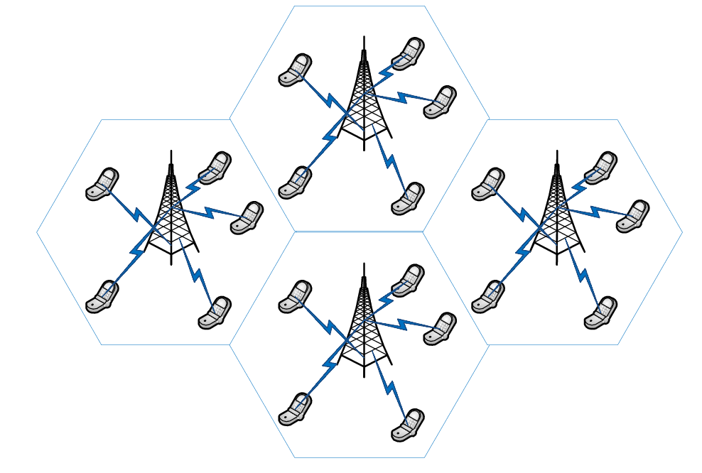
Cellular Wireless Networks Overview

Slide 9
Cellular Network Overview
Areas divided into cells
  Each Served by base station consisting of transmitter, receiver, and control unit
  Band of frequencies allocated
Base Station (BS) – includes an antenna, a controller, and a number of receivers
Mobile telecommunications switching office (MTSO) – connects calls between mobile units
Two types of channels available between mobile unit and BS
  Control channels
  Traffic channels

Slide 10
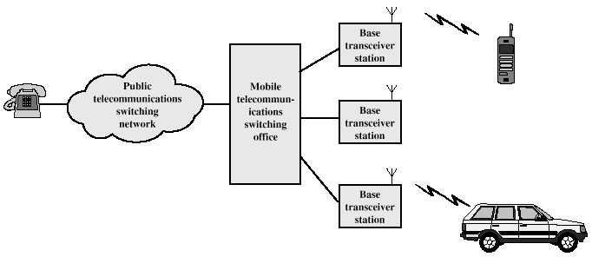
Cellular Network Overview

Slide 11
Frequency Reuse
Adjacent cells assigned different frequencies to avoid interference or crosstalk
Objective is to reuse frequency in nearby cells
  10 to 50 frequencies assigned to each cell
  Transmission power controlled to limit power at that frequency escaping to adjacent cells
  The issue is to determine how many cells must intervene between two cells using the same frequency

Slide 12

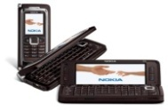
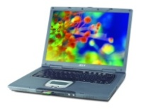
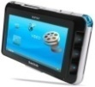
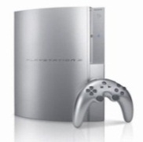

Frequency Reuse
Due to its scarcity, spectrum is reused
In licensed bands
and unlicensed bands
BS
Cellular, Wimax
Wifi, UWB,…
Reuse introduces interference

Slide 13
Cellular Systems
Reuse channels to maximize capacity
1G: Analog systems, large frequency reuse, large cells, uniform standard
2G: Digital systems, less reuse (1 for CDMA), smaller cells, multiple standards, evolved to support voice and data (IS-54, IS-95, GSM)
3G: Digital systems, WCDMA competing with GSM evolution.
4G: OFDMA/MIMO
5G:?
MTSO
(Mobile telecommunications switching office)
BASE
STATION

Slide 14
Approaches to Cope with Increasing Throughput Demand
Adding new channels
Frequency borrowing – frequencies are taken from adjacent cells by congested cells
Cell splitting – cells in areas of high usage can be split into smaller cells
Cell sectoring – cells are divided into a number of wedge-shaped sectors, each with their own set of channels
Microcells – antennas move to buildings, hills, and lamp posts

Slide 15
Different Types of Wireless Networks
From Infrastructure Point of View
  Infrastructure-based Networks
    Cellular Wireless Networks
      Macrocell
      Microcell
      Picocell
      Femtocell
    Relayed Wireless Networks
  Ad hoc/Sensor Wireless network
  Mesh Wireless Networks

Slide 16
Mesh vs. Ad-Hoc Networks
Ad-Hoc Networks
Wireless Mesh Networks
Multihop
Nodes are wireless, possibly mobile
May rely on infrastructure
Most traffic is user-to-user
Multihop
Nodes are wireless, some mobile, some fixed
It relies on infrastructure
Most traffic is user-to-gateway

Slide 17
Different Types of Wireless Networks
From Spectrum Access Point of View
  Traditional Wireless Radio network (Fixed Spectrum Access by licensed operator Only)
  Cognitive Radio Networks (Dynamic Spectrum Access)

Slide 18
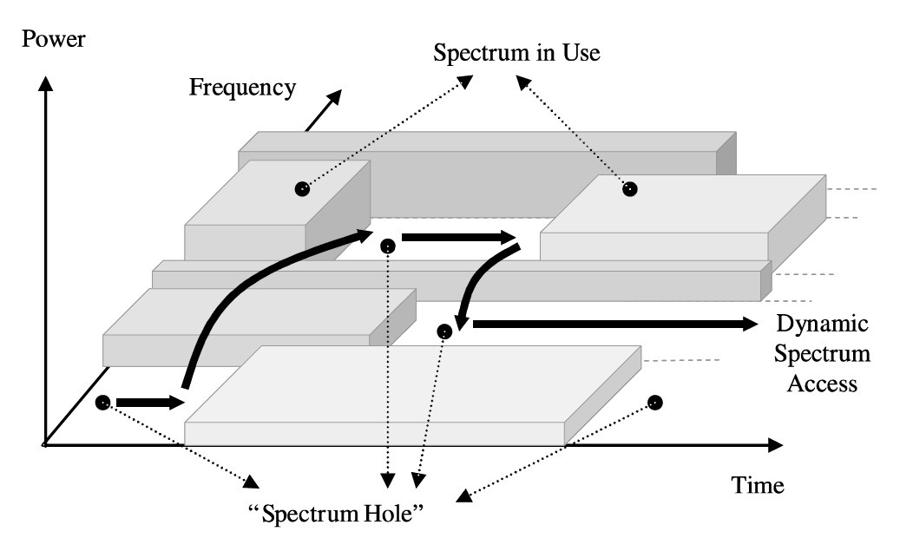
Spectrum Holes Concept

Slide 19
Cognitive Radio Network Terminology
Primary User (PU):
  Licensed user
  Has exclusive rights for the spectrum
Secondary User (SU):
  Unlicensed user
  Opportunistically utilizes the white spaces
  Has to vacate the spectrum band as soon as a PU appears
  Also called cognitive user

Slide 20
Dynamic Spectrum Access (DSA)
Problem :
  Underutilized spectrum resources due to fixed assignment strategy
Idea
  Utilizing “white spaces” or “spectrum holes” in the spectrum without disturbing licensed users
    Overlay Spectrum Access
    Underlay Spectrum Access
Challenges :
  Spectrum Sensing to decide to transmit (if so, with how much power?) or not
  Power/interference control

Slide 21
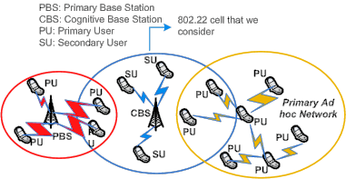
IEEE 802.22 Network Architecture

Slide 22
Different Types of Wireless Networks
From Heterogeneity Point of View
  Homogeneous Wireless Networks
  Heterogeneous Wireless Networks
    Connecting to Wireless Networks different in
      Cell sizes (macro/micro/pico/femto)
      Radio Access Technology (Carrier Frequency and MAC)
      Service Requirements (real time/non-real time/data/voice)
    Device-to-Device (D2D ) Communications

Slide 23
Homogeneous Wireless Networks Overview
Cellular Networks with Regular and the same cell size

Slide 24

Approaches to Cope with Increasing Throughput Demand
The complementary functions of the regulatory authorities and the standardization organizations can be summarized broadly by the following relationship:
Bandwidth
Spectral efficiency
What would be the third factor?

Slide 25
Heterogeneous Wireless Networks
The wireless capacity has doubled every 30 months since “The wireless capacity has doubled every 30 months over the last 104 years”
  -Martin Cooper of Arraycomm
This translates into an approximately million-fold capacity increase since 1957 (to 2007).
  25x improvement from wider spectrum
  5x improvement by dividing the spectrum into smaller slices
  5x improvement by designing better modulation schemes
  1600x gain through reduced cell sizes and transmit distance.
The main problem of current cellular network
  The expensive deployment cost of network infrastructure (60,000$/year/marcrocell )
  Low signal strength received from an outdoor BS inside a building
Notes:
From 1957 to 2007 we have 50 years or quivalently 50*12=600 months. For 600 months we have 600/30=20 number of 30 months which means 2^20=1000000 (approximately)

Slide 26
Heterogeneous Wireless Networks
The surest way to increase the system capacity of a wireless link is by getting the transmitter and receiver closer to each other, which creates the dual benefits of
  higher quality links and
  more spatial reuse.

Slide 27
Heterogeneous Wireless Networks
In a network with nomadic users, this inevitably involves deploying more infrastructure, typically in the form of
  Reduced cell size
    Macrocell,
    microcell,
    Picocell
    Femtocell
  Relays (Distributed antennas)
    Fixed-relay or Cooperative-mobile-relay
    Amplify and forward, or decode and forward

Slide 28
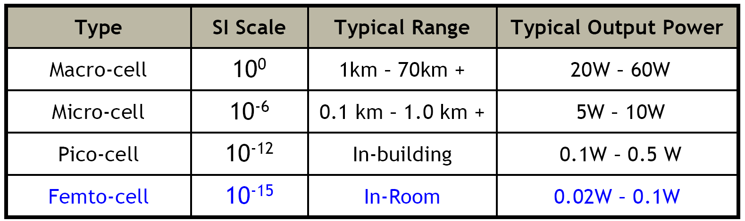
Evolution of Cellular Networks
Usage:
Macrocell: Rural, highway.
Microcell: Urban, street.
Picocell: building, enterprise, station.
Femtocell: indoor, very high-data-rate coverage.
Source: [1]
[1]- Aaron Dow, “Evolution to Femto Cells for Radio Access ⎯Challenges for existing cellular networks,” Alcatel-Lucent

Slide 29
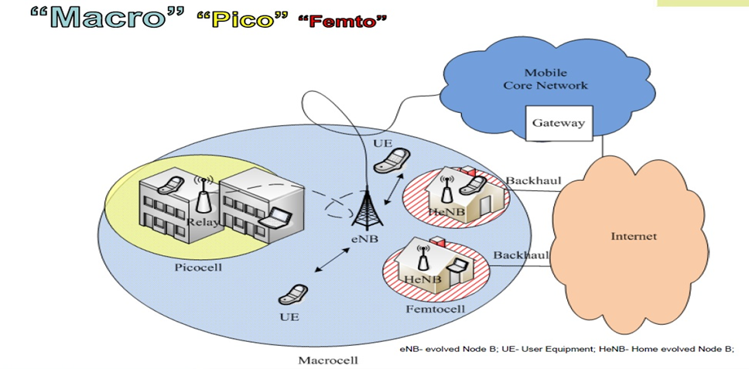
Evolution of Cellular Networks
8/26

Slide 30

Evolution of Cellular Systems
Single Base Station
Macro Stations

Slide 31

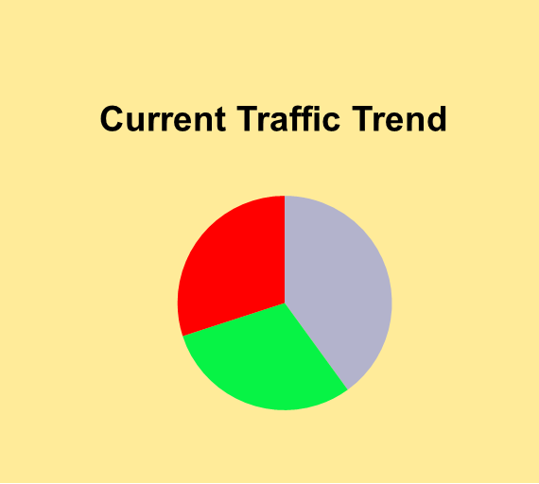
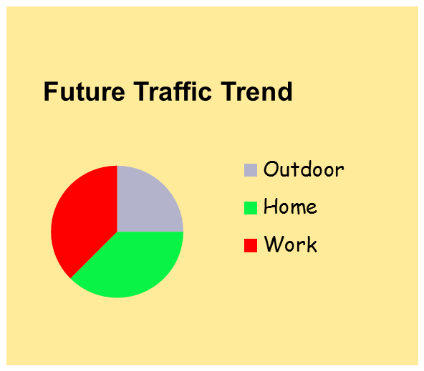
Evolution of Cellular Systems
2G
3G
4G
As throughput demand and usage increases, cell size decreases
Why Femtocell?
Macro Base Stations
Femto Stations
Notes:
Why femtocell?
1- getting transmiter and receiver closer
2- current and future traffice trend is toward indoor communication

Slide 32
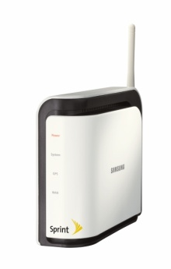
Need for Femtocells
Macrocell cannot provide good signal strength for indoor coverage
Higher data rate– Femtocells can enable higher
capacity
Reduce the power on the macrocells
“Femtocells are low-power wireless access points that operate in licensed spectrum to connect standard mobile devices to a mobile operator’s network using residential DSL or cable broadband connections”

Slide 33
Benefits of Femtocells
Better coverage and capacity
  Due to short transmit-receive distance
    • Lower transmit power
    • Prolong handset life
    • Higher SINR
    • Higher spectral efficiency
Improved macro reliability
  BS can provide better reception for mobile users
    Traffic originating indoors can be absorbed into femtocell networks over IP backbone
Cost Benefit
  60,000$/year/marcrocell vs. 200$/year/femtocell
Reduced subscriber turnover
  Enhanced home coverage will reduce motivation for users to switch carriers

Slide 34
Benefits of Femtocells
Capacity benefits of femtocell
  Reduced distance between sender and receiver leads to higher signal strength (capacity improvement
  Lowered transmit power decrease the interference for neighboring cells (capacity improvement)
  Femto-AP can devote a larger portion of resource for fewer users (frequency efficiency)

Slide 35
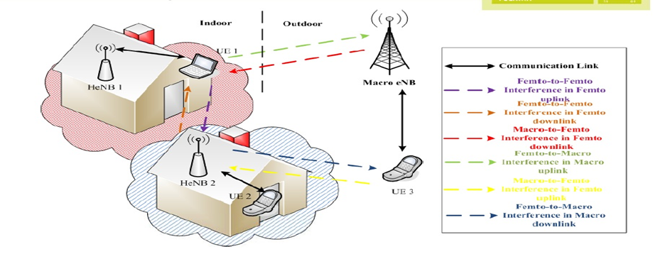
Technical Challenges: Interference Management
Power control is required in Femto-AP to avoid interference for outdoor users
  Marcocell-to-Femtocell Interference
  Femtocell-to-Femtocell Interference
  Femtocell-to-Marcocell Interference

Slide 36
Approaches to Cope with Increasing Throughput Demand
The complementary functions of the regulatory authorities and the standardization organizations can be summarized broadly by the following relationship:
Bandwidth
Spectral efficiency
What would be the third factor?
  Area Spectral Efficiency

Slide 37
Approaches to Cope with Increasing Throughput Demand
a) Increased bandwidth
b) Increased spectral efficiency
c) Area Spectral Efficiency: Extreme densification
  To improve the area spectral efficiency.
  Put differently, more active nodes per unit area and Hz
  Heterogeneous Networks (Macro/Pico/Femto cells)

Slide 38
Area Spectral Efficiency
    From Spectral Efficiency to Area Spectral Efficiency (Overall Network Efficiency)
  It becomes essential that the future focus of wireless technology shifts from further increasing the spectral efficiency of the radio link to improving the overall network efficiency through extreme densification and offloading via heterogeneous network architecture
Road Ahead:
  From link optimization to overall network optimization

Slide 39

Device to Device (D2D) Communication
One of the Third Generation Partnership Project Long Term Evolution commitments is to provide high data rate services for next-generation cellular.
Local Area Connections, which benefits from short distance communications, was chosen as a way of gaining high data rate
Device-to-Device (D2D) concept was born.

Slide 40

Device to Device (D2D) Communication
Other potential benefits include better spatial spectrum reuse
Energy Saving due to possibly lower transmission power
Extending cellular coverage

Slide 41
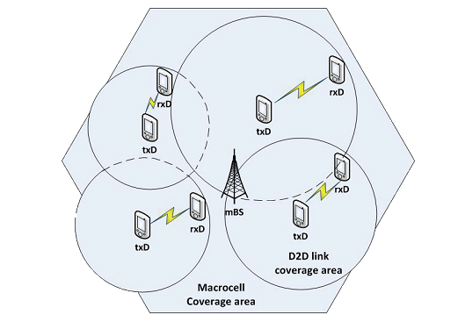

Introduction to D2D
D2D Communication Classification:
  Inband D2D: Using the cellular spectrum for both D2D and cellular links
    Overlay
    Underlay
  Outband D2D: D2D links exploit unlicensed spectrum
[Image ] Erturk, M.C.; Mukherjee, S.; Ishii, H.; Arslan, H., "Distributions of Transmit Power and SINR in Device-to-Device Networks," Communications Letters, IEEE , vol.17, no.2, pp.273,276, February 2013

Slide 42
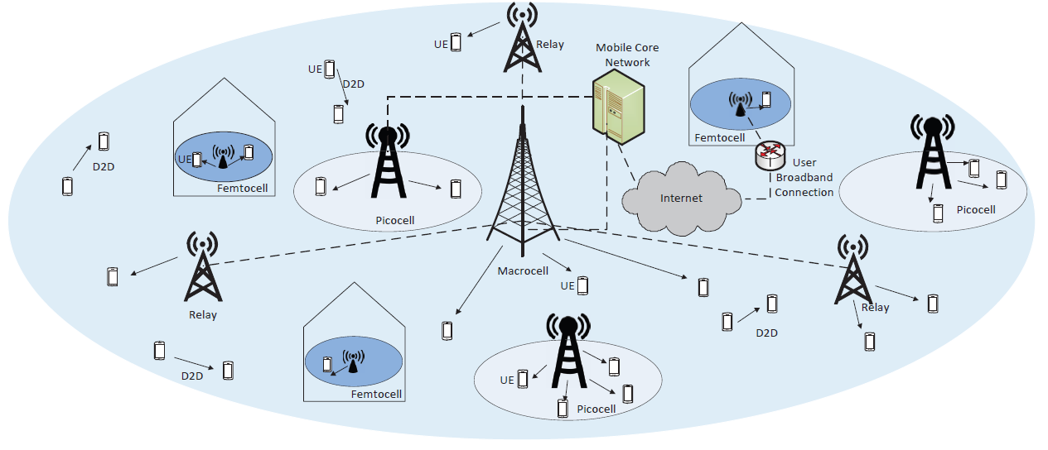
4G and 5G Heterogeneous Wireless Networks

Slide 43
Different Types of Wireless Networks
From Greenness (Energy Consumption) Point of View
  Green Wireless Networks
  Energy Harvesting Wireless Network
  Conventional Wireless Networks (non-green and without Energy Harvesting)

Slide 44
Energy Consumption
Increasing energy costs with higher base station site density and energy price trends
Corporate Responsibility targets set to reduce carbon emissions and environmental impacts of networks
The Base Station is one of the most energy–consumer component of a wireless network

Slide 45
Lecture 2 Outline
Different Types of Wireless Networks
Taxonomy of Hot Topics Research Areas on Resource Allocation in Wireless Networks
Summary and Concluding Remarks
  How To Approach Resource Allocation Problems?
  Guidelines on How to Select The Term Project

Slide 46
Research Areas in Resource Allocation in Wireless Networks
Resource allocation problems in wireless network can be classified according to
  Resources or Functions in each layer
  Wireless Network Types
    From Infrastructure point of view
    From MAC Type Point of View
    From Spectrum Access point of view
    From Heterogeneity Point of View
    From Greenness Point of View

Slide 47
Resources\Functions in Each Layer
Physical Layer Resources
  Bandwidth
  Power
  Base-station
  Rate
  Modulation Scheme
  Antenna
Data Link Layer Resources
  Channel Assignment (Medium Access)
    (FDMA/TDMA/CDMA/SDMA or Random Access)
  Flow (Packet Rate) Control
Network Layer Resources
  Route
  Congestion Control/queue management

Slide 48






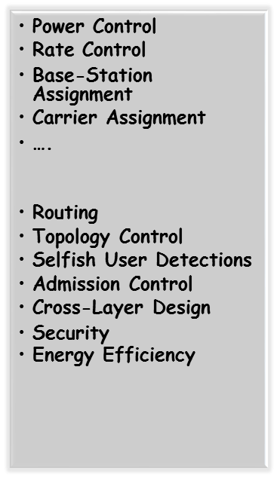




Toward a Taxonomy of Hot Topic Researches on Resource Allocation in Wireless Networks

Slide 49




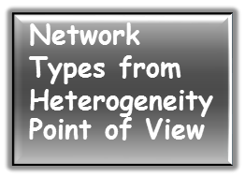

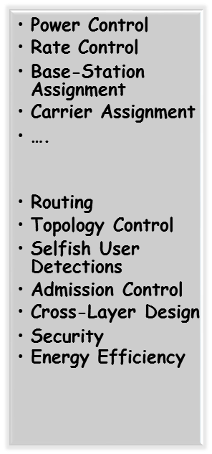





Toward a Taxonomy of Hot Topic Researches on Resource Allocation in Wireless Networks

Slide 50
Toward a Taxonomy of Hot Topic Researches on Resource Allocation in Wireless Networks
From Infrastructure and MAC points of View:
  Resource Allocation in {CDMA/ODFDMA/TDMA/SDMA} Cellular Networks
  Resource Allocation in {CDMA/ODFDMA/TDMA/SDMA} Femto-cell Networks
  Resource Allocation in {CDMA/ODFDMA/TDMA/SDMA} Mobile Ad Hoc/Sensor/Networks
  Resource Allocation in {CDMA/ODFDMA/TDMA/SDMA} Mesh Networks
From Spectrum Access Point of View
  Resource Allocation in Cognitive Radio Networks

Slide 51
Resource Allocation Problems in CDMA Cellular Wireless Networks
Uplink and Downlink Resource Allocation
  Power Control
  Power Control and gradual removal problem
  Joint Power and Rate Control
  Joint power control and base-station assignment

Slide 52
Power Control in CDMA Cellular Wireless Networks
Required readings for starting
  M. Chiang, P. Hande, and T. Lan, Power Control in Wireless Cellular Networks, Now Publishers Inc, 2008.
  R. D. Yates, “A framework for uplink power control in cellular radio systems,” IEEE Journal on Selected Areas in Communications,1995.
  C. W. Sung and K. Leung, “A generalized framework for distributed power control in wireless networks,” IEEE Transactions on Information Theory, 2005.
  K. Leung and C. W. Sung, “An opportunistic power control algorithm for cellular network,” IEEE/ACM Transaction on Networking, vol. 14, no. 3, pp. 470-478, June 2006.
  G. J. Foschini, and Z. Milijanic, “A simple distributed autonomous power control algorithm and its convergence,” IEEE Transactions on Vehicular Technology, 1993.
  F. Berggren, R. Jantti, and S. Kim, “A generalized algorithm for constrained power control with capability of temporary removal,” IEEE Transactions on Vehicular Technology, 2001.

Slide 53
Power Control in CDMA Cellular Wireless Networks
  M. Rasti, A. R. Sharafat, and B. Seyfe, “Pareto efficient and goal driven power control in wireless networks: A game theoretic approach with a novel pricing scheme,” IEEE/ACM Transactions on Networking, 2009.
  M. Rasti, A. R. Sharafat, and J. Zander, “A distributed dynamic target-SIR tracking power control algorithm for wireless cellular networks,” IEEE Transactions on Vehicular Technology, Feb. 2010.
  M. Rasti, A. R. Sharafat, and J. Zander, “A Distributed Pareto and energy efficient power control algorithm with Feasibility Check in wireless networks”, IEEE Transactions on Information Theory, 2010.
  M. Rasti and A. R. Sharafat, “Distributed power control with soft removal in wireless networks,” IEEE Transactions on Communications, 2010.

Slide 54
Resource Allocation in OFDMA Cellular Wireless Networks
Uplink /Downlink Resource Allocation
  Power Control
  Sub-Carrier Allocation
    Algorithms
    Using other Multiple access techniques to select subcarriers
      For instance: “Generalized CSMA/CA for OFDMA Systems: Protocol Design, Throughput Analysis, and Implementation Issues” by H. Kwon et al.

Slide 55
Resource Allocation in OFDMA Cellular Wireless Networks
Required reading for starting
  S. Sadr, A. Anpalagan, and K. Raahimifar, “Radio resource allocation algorithms for the downlink of multiuser OFDMA Communication Systems, “ IEEE Communication Survey & Tutorials, 2009.
  E. Yaacoub and Z. Dawy, “A survey on uplink resource allocation in OFDMA wireless networks”, IEEE Communication Survey & Tutorials, 2011.

Slide 56
Resource Allocation Problems in FemtoCell Networks
Power control in Femto-Cell networks
Medium access control in Femto-Cell networks
Required reading for starting:
  V. Chandrasekhar and J. G. Andrews, “Femtocell networks: a survey,” IEEE Communications Magazine, 2008.

Slide 57
Resource Allocation Problems in Wireless Ad Hoc Networks
Power and topology control in mobile ad hoc networks
Cooperation enforcement/selfish user detection
Medium access control in mobile ad hoc networks
  T. Issariyakul, E. Hossain, and D. I. Kim, “Medium access control protocols for wireless mobile ad hoc networks: Issues and approaches,” Wireless Communications and Mobile Computing, 2003.
Notes:
Depending on resource, the mac types may be or may not be important. For instance, if routing in MANET is studied without taking into account the effect of physical layer resource like power, we don’t care the mac type. But if we take the mac type into account in routing determination and packet forwarding, we have to determine which type of MAC is employed by nodes.

Slide 58
Resource Allocation Problems in Wireless Mesh Networks
Power and topology control in Mesh networks
Medium access control in Mesh networks
Routing
Required reading for starting
  I.F. Akyildiz, et.al., “Wireless Mesh Networks; A Survey”, Computer Networks Journal, 2005.

Slide 59
Resource Allocation in Cognitive Radio Networks
Physical Layer Issues
  Power/interference management/control
  Spectrum Sensing
Link-Layer Issues
  Media Access Control
    Spectrum Sensing to decide to transmit (if so, with how much power?) or not
      A. D. Domenico, et al, “A survey on MAC Strategies for Cognitive Radio Networks,” IEEE Communication Survey & Tutorials, 2012.

Slide 60
Resource Allocation in Cognitive Radio Networks
Required reading for starting
  Besting Reading Topics on Cognitive Radio, Available Online at http://www.comsoc.org/best-readings/topic/cognitive-radio
  Mitola, J., “Cognitive Radio: An Integrated Agent Architecture for Software Defined Radio”, PhD Thesis, Royal Institute of Technology, (KTH), Sweden, 2000.
  S. Haykin, “Cognitive radio: Brain-empowered wireless communications,” IEEE Journal on Selected Areas in Communications, vol. 23, no. 2, pp. 201-220, February 2005.
  I. F. Akyildiz, W.-Y. Lee, M. C. Vuran, and S. Mohanty, “NeXt generation/dynamic spectrum access/cognitive radio wireless networks: A survey,” Computer Networks (Elsevier), vol. 50, no. 13, pp. 2127-2159, September 2006.
  Q. Zhao and B. M. Sadler, “A survey of dynamic spectrum access,” IEEE Signal Processing Magazine, vol. 24, no. 3, pp. 79-89, May 2007.
  M. Buddhikot, “Understanding dynamic spectrum access: Models, taxonomy and challenges,” in Proc. of IEEE DySPAN 2007, April 17-21, 2007

Slide 61
Resource Allocation in Cognitive Radio Networks
Required reading for starting
  Eibei Wang; Liu, K.J.R. “Advances in cognitive radio networks: A survey” IEEE Journal of Selected Topics in Signal Processing, 2011
  T. Yucek and H. Arsalan, “A Survey of Spectrum Sensing Algorithm for Cognitive Radio Applications,” IEEE Communications Surveys and Tutorials
  E. Hossain, D. Niyato, and Z. Han, “Dynamic Spectrum Access and Management in Cognitive Radio Networks,” Cambridge University Press, 2009.
  Akyildiz et al, “A Survey on Spectrum Management in Cognitive Radio Networks”
  Akyildiz et al, “Cooperative spectrum sensing in cognitive radio networks: A survey”, 2010
  G. Salami, O. Durowoju, A. Attar, O. Holland, A. H. Aghvami and R. Tafazolli, “A Comparison Between the Centralized and Distributed Approaches for Spectrum Management,” IEEE Communications Surveys and Tutorials, (99) (2010) 1-17.

Slide 62
Resource Allocation in Cognitive Radio Networks
M. Youssef, et al, “Routing Metrics of Cognitive Radio networks A Survey,” IEEE Communications Surveys and Tutorials, 2013

Slide 63
Toward a Taxonomy of Hot Topic Researches on Resource Allocation in Wireless Networks- Further Subjects
Resource Allocation in CDMA Wireless Networks
Resource Allocation in OFDMA Wireless Networks
Resource Allocation in SDMA (MIMO) Wireless Networks
Resource allocation in Femtocell Networks
Resource Allocation in Mobile Ad Hoc Networks
Resource Allocation in Mesh Networks
Resource allocation in Cognitive Radio Networks
Admission Control
Priority-based resource allocation
Cross Layer resource allocation
Traffic Scheduling
Game Theoretic Analysis of Resource Allocation
Security in Cognitive radio networks
Energy Efficiency (Green Communication)

Slide 64
Research Areas in Resource Allocation in Wireless Networks
Admission Control
  Required Readings for starting
    M. H. Ahmed, “Call admission control in wireless networks: a comprehensive survey,” IEEE Communications Surveys and Tutorials, 2005.
    M. Ghaderi and R. Boutaba, “Call admission control in mobile cellular networks: a comprehensive survey,” Wireless Communications and Mobile Computing, 2006.
Priority-based resource allocation
  Priority-based multiple access (in allocating subcarrier in OFDMA and in Random Access Networks)
  Priority-based admission control
    Joint power and admission control
  Resource allocation problems in cognitive radio network is a priority-based resource allocation problem!

Slide 65
Research Areas in Resource Allocation in Wireless Networks
  Cross Layer Design
  “Cross layer resource allocation in wireless networks: Techniques and Models from PHY and MAC Layer Interaction” by A. Neira and M. R. Campalans
Traffic Scheduling
  M. Andrews, “A survey of scheduling theory in wireless data networks,” in Proceedings of IMA Summer Workshop on Wireless Communications, 2005

Slide 66
Research Areas in Resource Allocation in Green Wireless Networks
  Energy Efficiency
  D. Feng and et al., “A Survey of Energy-Efficient Wireless Communications” IEEE Communication Survey & Tutorials, 2013
  A. Bianzino, et al, “A Survey of Green Networking Research”, IEEE Communications Surveys and Tutorials, 2012
  Z. Hasan, et al, "Green cellular networks: A survey, some research issues and challenges," IEEE Communications Surveys Tutorials, 2011
  Best Readings topic on Green Communications, IEEE Communications Society, Online Available at http://www.comsoc.org/best-readings

Slide 67
Research Areas in Resource Allocation in Green Wireless Networks
  Z. Hasan, H. Boostanimehr, V. K. Bhargava, “Green Cellular Networks: A Survey, Some Research Issues and Challenges”, 2011.

Slide 68
Research Areas in Resource Allocation in Heterogeneous Wireless Networks
Best Readings in Multi-Tier Cellular, IEEE Communications Society, Online Available at http://www.comsoc.org/best-readings

Slide 69
Research Areas in Resource Allocation in Green Wireless Networks
K. Son, H. Kim, Y. Yi, and B. Krishnamachari, "Base station operation and user association mechanisms for energy-delay tradeo s in green cellular networks," IEEE Journal on Selected Areas in Communications, vol. 29, no. 8, pp. 1525-1536, 2011
Facing the ever-growing energy-efficiency challenge of wireless cellular networks, a theoretical framework for base-station (BS) energy saving has been thoroughly developed in this paper, which integrates the dynamic BS operation mechanisms with the relevant mobile terminal/user association processes, in order to realize a total network cost minimization allowing for a flexible tradeoff between the low-level performance and the energy consumption while obtaining optimal energy-efficient user association.

Slide 70
Research Areas in Resource Allocation in Green Wireless Networks
M. Marsan and M. Meo, "Energy efficient management of two cellular access networks," ACM SIGMETRICS Performance Evaluation Review, vol. 37, no. 4, pp. 69-73, 2010
The article addresses an interesting energy-aware cooperative management technique for two-operator cellular access networks. It proposes to switch off the networks whose traffic is very low while allowing their users to use one of the cooperating networks as roaming customers. The authors show that with different switching patters a substantial amount of energy could be saved.

Slide 71
Research Areas in Resource Allocation in Green Wireless Networks
B. Badic, T. O'Farrrell, P. Loskot, and J. He, "Energy efficient radio access architectures for green radio: Large versus small cell size deployment," in IEEE Vehicular Technology Conference Fall (VTC 2009-Fall), 2009, pp. 1-5, Sept. 2009
The authors study the relation between the energy consumption performance and reducing the cell size in cellular radio access networks. Energy consumption ratio and energy consumption gain are used to evaluate this performance when the cell size is reduced for a certain user density and service area. They investigate two different architectures where sleep mode is used in one of them along with a small-cell deployment.
S. Zhou, J. Gong, Z. Yang, Z. Niu, and P. Yang, "Green mobile access network with dynamic base station energy saving," in Proc. ACM MobiCom, vol. 9, 2009
This is one of the very early papers on base station (BS) energy saving issues within the mobile cellular access networks, which deals with dynamically turning off certain BSs when the network traffic is low and implements the centralized and decentralized power saving algorithms while paying specific attention to the cellular coverage guarantee.

Slide 72
Research Areas in Resource Allocation in Green Wireless Networks
E. Oh, B. Krishnamachari, X. Liu, and Z. Niu, "Toward dynamic energy-efficient operation of cellular network infrastructure," IEEE Communications Magazine, vol. 49, no. 6, pp. 56-61, 2011
This is a significant work which discusses how dynamic operation of base stations can contribute to significant energy savings in cellular networks. The idea is to turn off redundant base stations when they are under low traffic condition. Some open issues associated with implementing energy efficient dynamic operation of base stations are also discussed.
F. Richter, A. Fehske, and G. Fettweis, "Energy efficiency aspects of base station deployment strategies for cellular networks," in Proc. IEEE Vehicular Technology Conference Fall (VTC 2009-Fall), 2009
This paper provides a detailed mathematical model that demonstrates that the choice of cell size has a significant impact on the energy consumption of a wireless network. Their results suggest that for a given network there is an optimal cell size that minimizes energy consumption.

Slide 73
Research Areas in Resource Allocation in Green Wireless Networks
Energy harvesting, storage, and recycling
Aman Kansal, et al, "Power management in energy harvesting sensor networks", ACM Transactions on Embedded Computing Systems, 2007
This paper discussed issues in power management for energy-harvesting sensor networks. The authors pinoeerly developed abstractions to characterize the complex time varying nature of such sources with analytically tractable models and use them to address key design issues. The authors also develop distributed methods to efficiently use harvested energy.
Chin Keong Ho, Rui Zhang, "Optimal Energy Allocation for Wireless Communications With Energy Harvesting Constraints", IEEE Transactions on Signal Processing, 2012
In this paper, the authors considered maximizing the throughput through the the energy allocation over a finite horizon. Two types of side information (SI) on the channel conditions and harvested energy are assumed to be available: causal SI (of the past and present slots) or full SI (of the past, present and future slots). Through the use of dynamic programming and convex optimization techniques, the structural results for the optimal energy allocation were obtained. In the case of the unlimited energy storage and the full SI, the authors prove the optimality of a water-filling energy allocation solution where the so-called water levels follow a staircase function.

Slide 74
Research Areas in Resource Allocation in Green Wireless Networks
Energy harvesting, storage, and recycling
S. Sudevalayam, P. Kulkarni, "Energy Harvesting Sensor Nodes: Survey and Implications", IEEE Communications Surveys & Tutorials, 2011
In this paper, the authors have made a timely survey on various aspects of energy harvesting sensor systems- architecture, energy sources and storage technologies. This paper also has investigated some insights into implications of recharge opportunities on node-level operations and design of sensor network applications and solutions.
J.P. Barton, D.G. Infield, "Energy storage and its use with intermittent renewable energy", IEEE Transactions on Energy Conversion, vol. 19, no. 2, pp. 441-448, June 2004
This paper discusses on the connection of wind generators at locations where the level of embedded renewable generation (ERG) would be limited by the voltage increase. Short-term storage offers only a small increase in the amount of electricity that could be absorbed by the network. Storage over periods of up to one day delivers greater energy benefits, but is significantly more expensive. This paper compare different feasible electricity storage technologies for their operational suitability over different time scales. This paper also investigate the value of storage regarding to the power rating and energy capacity so as to adapt appropriate sizing.

Slide 75
Research Areas in Resource Allocation in HetNet
J. G. Andrews, "The Seven Ways HetNets are a Paradigm Shift", IEEE Communications Magazine, March 2013.
This paper explains seven major ways that small-cell networks are different than traditional tower-based cellular networks, and associated technical and research challenges, and recommendations.
V. Chandrasekhar, J. Andrews, and A. Gatherer, “Femtocell networks: a survey,” IEEE Communications Magazine, vol. 46, no. 9, pp. 59–67, 2008.
This article overviews the technical and business arguments for femtocells and describes the state of the art on each front.
H. Claussen, L. T. W. Ho, and L. G. Samuel, “An overview of the femtocell concept,” Bell Labs Technical Journal, vol. 13, no. 1, pp. 221–245, May 2008.
In this paper, a user-deployed femtocell solution based on the base station router (BSR) flat Internet Protocol (IP) cellular architecture is presented.

Slide 76
Research Areas in Resource Allocation in HetNet
A. Damnjanovic, J. Montojo, Y. Wei, T. Ji, T. Luo, M. Vajapeyam, T. Yoo, O. Song, and D. Malladi, “A survey on 3GPP heterogeneous networks,” IEEE Wireless Communications, vol. 18, no. 3, pp. 10–21, 2011.
This paper surveys current state-of-the-art in heterogeneous deployments and focus on 3GPP LTE air interface to describe future trends.
A. Ghosh, N. Mangalvedhe, R. Ratasuk, B. Mondal, M. Cudak, E. Visotsky, T. A. Thomas, J. G. Andrews, P. Xia, H. S. Jo, H. S. Dhillon, and T. D. Novlan, "Heterogeneous Cellular Networks: From Theory to Practice", IEEE Communications Magazine, vol. 50, no. 6, June 2012.
This article discusses new theoretical models for understanding the heterogeneous cellular networks of tomorrow, and the practical constraints and challenges that operators must tackle in order for these networks to reach their potential.

Slide 77
Research Areas in Resource Allocation in HetNet
R. Kim, J. S. Kwak, and K. Etemad, “WiMAX femtocell: requirements, challenges, and solutions,” IEEE Communications Magazine, vol. 47, no. 9, pp. 84 –91, Sep. 2009.
This article presents an overview of WiMAX femtocell requirements, deployment models, and solutions in the near and long terms.
Z. Hasan, H. Boostanimehr, and V. K. Bhargava, “Green Cellular Networks: A Survey, Some Research Issues and Challenges,” IEEE Communications Surveys and Tutorials, vol. 13, pp. 524–540, 2011.
This paper provides a comprehensive survey on techniques to obtain energy savings in base stations, by discussing how heterogeneous network deployment based on micro, pico and femtocells can be used to achieve this goal.
A. Khandekar, N. Bhushan, J. Tingfang, and V. Vanghi, “LTE-Advanced: Heterogeneous networks,” in Proceedings of IEEE Wireless Conference (EW), European, 2010, pp. 978–982.
This paper discusses the need for an alternative deployment model or topology using heterogeneous networks for LTE-Advanced.

Slide 78
Research Areas in Resource Allocation in HetNet
N.M. Mosharaf Kabir Chowdhury, R. Boutaba, “Network virtualization: State of the art and research challenges,” IEEE Communications Magazine, vol. 47, no. 7, pp. 20–26, July 2009.
This article investigates the past and the state of the art in network virtualization along with the future challenges that must be addressed to realize a viable network virtualization environment.
A. Damnjanovic, J. Montojo, Y. Wei, T. Ji, T. Luo, M. Vajapeyam, T. Yoo, O. Song, D. Malladi, “A survey on 3GPP heterogeneous networks,” IEEE Wireless Communications, vol. 18, no. 3, pp. 10–21, June. 2011.
This article discusses the need for an alternative strategy, where low power nodes are overlaid within a macro network, creating what is referred to as a heterogeneous network.
E. Hossein, M. Rasti, H. Tabassum, and A. Abdelnasser, “Evolution toward 5G multi-tier cellular wireless networks: An interference management perspective”, IEEE Wireless Communications, 2014.

Slide 79
Research Areas in Resource Allocation in D2D Communication
M. N. Tehrani, M. Uysal , and H. Yanikomeroglu, “Device-to-device communication in 5G cellular networks: Challenges, solutions, and future directions,” IEEE Communication Magazin, 2014
A. Asadi, Q. Wang, and V. Mancuso, “A Survey on Device-to-Device Communication in Cellular Networks”, arxiv

Slide 80
Lecture 2 Outline
Different Types of Wireless Networks
Taxonomy of Hot Topics Research Areas on Resource Allocation in Wireless Networks
Summary and Concluding Remarks
  How To Approach Resource Allocation Problems?
  Guidelines on How to Select The Term Project

Slide 81
How To Approach Resource Allocation Problems?
All resource allocation problems are some kind of optimization problem
Steps required to state and solve a resource allocation problem
  System model?
  Resources?
  Problem formulation?
  Approache to solve?

Slide 82
How To Approach Resource Allocation Problems?
System model
  Wireless Network Type
    Infrastructure?
    MAC?
    Spectrum Access?
  Notation
  Relations/formulas
Resources
  Power
  Carrier
  Rate
  ….

Slide 83
How To Approach Resource Allocation Problems?
Problem formulation
  Objective function (a function of resources)?
    Throughput
    Fairness
    Outage probability
    Power consumption
    QoS
    ….
  Constraints?
    Hardware constraints
    Service requirement constraints
    Regulation body constraint
Approach to solve
  Centralized
  Distributed
  Game theory/Graph Theory/....

Slide 84
Lecture 2 Outline
Different Types of Wireless Networks
Taxonomy of Hot Topics Research Areas on Resource Allocation in Wireless Networks
Summary and Concluding Remarks
  How To Approach Resource Allocation Problems?
  Guidelines on How to Select The Term Project

Slide 85
Guidelines to Choose Your Term Project
Choose your (hot topic?) research area
Starting from a tutorial or survey paper on selected subject if available
Search and find many papers on the subject
Reach most appropriate journal/conference papers among available papers (filtering papers!) according to
  Your interest
  Your background and abilities
  Hope to make contribution

Slide 86
Guidelines to Choose Your Term Project
Read very carefully selected papers
  Try to deeply understand the theoretical points and try to simulate and verify the simulation results
  You may reach a new good related paper when reading a paper by looking at its references
Try to improve the performance by
  Try to criticize the selected papers (positive and negative aspects)
  Modifying adequately the algorithm proposed (or theoretical framework developed ) in selected (referenced) papers
  Combining the algorithms proposed in selected papers in an adequate manner to improve the performance as compared to the individual one

